Slide 1
Source Code Authorship Attribution and Verification under
Adversarial Conditions
Team 16: Elang Sisson and Andrew Varkey

Slide 2
Introduction
Project Purpose: Investigate the robustness of source code authorship attribution systems against adversarial attacks through misattribution and evasion techniques.
Sprint 2 Goals:
  Finish Threat Model Documentations and Expand evasion techniques
  Establish an initial misattribution with the models
  Analyze causes of misattribution in depth
Team Roles
  Elang Sisson - Adversarial Attack Implementation & Testing
  Andrew Varkey - Adversarial Attack Implementation & Testing

Slide 3
Sprint 2 Objectives
Defined Objectives:
  Train authorship attribution classifiers on given dataset
  Establish a baseline attribution by modifying source code
  Analyze causes of misattribution in
  Define testing framework for future adversarial evaluation
Key Goals and Rationale:
  Feature Engineering
    Extract code stylistic features (naming conventions, indentations, comments)
    Rationale: Capture both content and stylistic signatures for accurate attribution
  Model Persistence
    Track trained models, vectorizers, scalers, and feature selectors
    Rationale: Allow consistent adversarial testing without retraining the models
Connection to Overall Vision:
  Sprint 2 helps us establish a baseline attribution system and attack method. This groundwork is important in measuring evasion and misattributions rates in our models.

Slide 4
Feature Implementation
Implemented both by Elang and Andrew:
Before:
Unfinished Threat Model
No model or data to perform stylometry attribution evasion attack techniques
After:
Finished Threat Model that highlights the different stylometry evasion attack techniques and how to mitigate them
Model that attributes source code based on 4 classifiers.
Dataset consisting of test data and training data
Validation:
There are results across 4 different classifiers that return the misattribution rates. The classifiers identifies which models are most vulnerable to evasion by outputting confidence scores. This addresses the goal of our research provided by our client in understanding which authorship attribution models are robust against code style evasion.

Slide 5
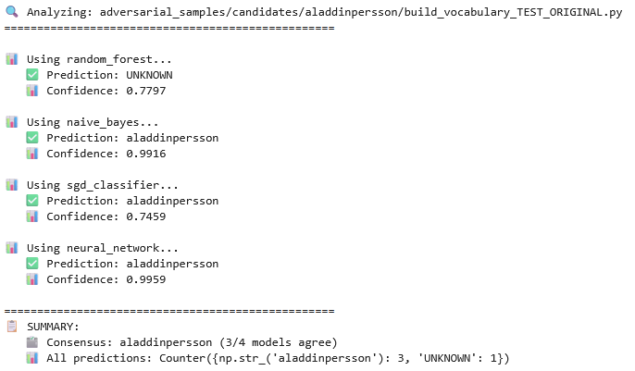
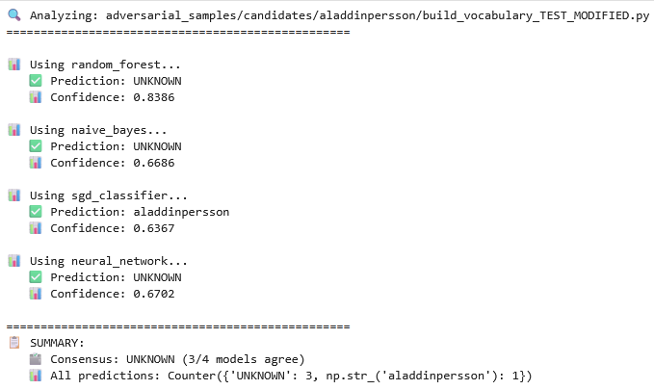
Original
Modified
Demo of Results

Slide 6
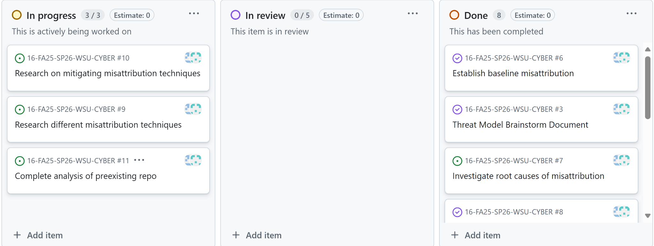
Kanban Overview & Team Contributions
Both Elang and Andrew were able to contribute to all reports and completing the Threat Model (Andrew - Model scope) (Elang - STRIDE Threats)
Elang primarily executed our first baseline misattribution attack (Semantic preserving transformations)

Slide 7
Figma Prototype & Client Feedback
Irrelevant since we are not working with any UI

Slide 8
Website Development on Wix, WordPress, or Similar Platform
Irrelevant since we are not working on Web Development

Slide 9
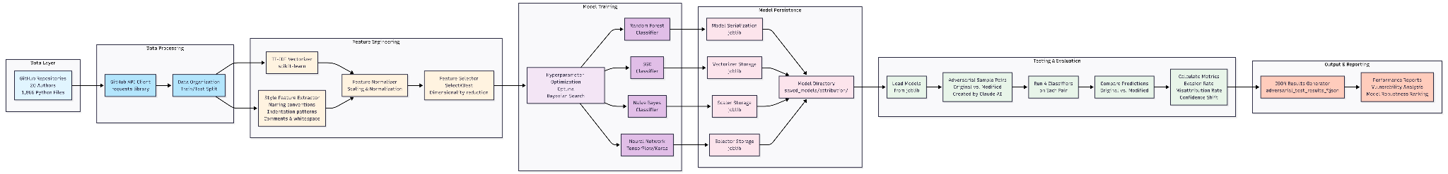
System Architecture
Feature Overview: The adversarial stylometry system consists of six major pipeline stages that process code samples though data collection, feature engineering, model training, persistence, and adversarial evaluation.
Components & Data Flow:
Data Layer -> Data Processing -> Feature Engineering -> Model Training -> Model Persistence -> Testing & Evaluation -> Output Results
Database Design and UI Design NOT APPLICABLE! We don’t use either of those for this project!

Slide 10
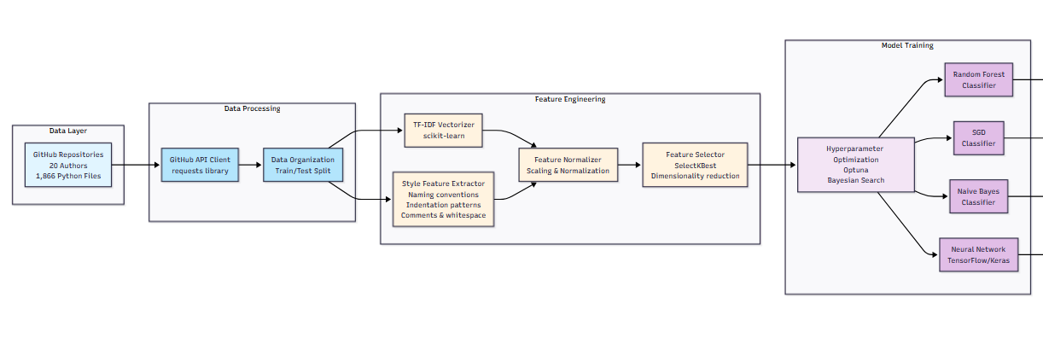
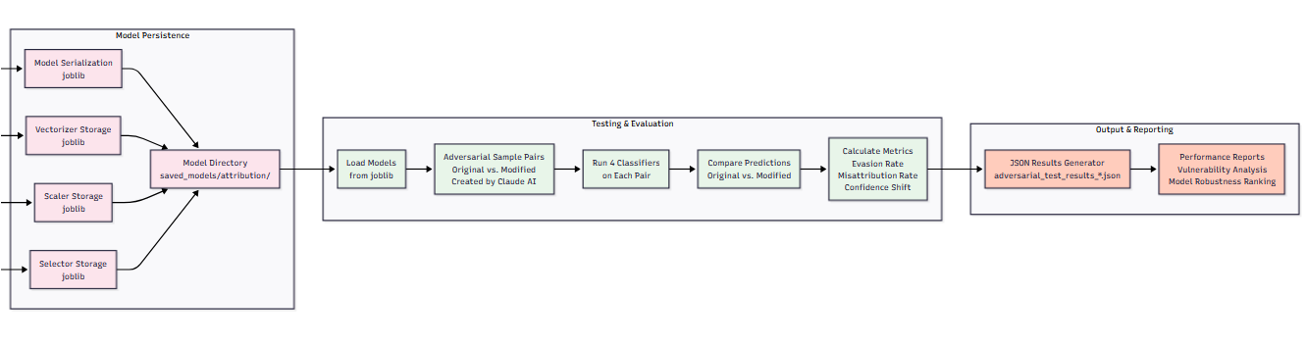
Diagram of data flow (Enlarged image from previous slide)

Slide 11
Testing Plan (In the future)
We have not reached the phase where testing is relevant yet since we are still establishing baseline analyzations.
Unit Testing:
Validate model predictions on code samples
Test feature extraction consistency
Verify Confidence score outputs
Integration Testing:
Verify prediction changes after code modifications
System Testing:
Evasion Rate Measurement: Percentage of samples where true author is no longer correctly identified after modification.
Confidence Score Analysis: Track how confidence drops when adversarial modifications are made
Model Comparison: Compare which classifiers are most/least vulnerable to evasion
Root Cause Analysis: Identify which code transformations are most effective

Slide 12
Sprint Achievements and Challenges
Achievements:
Completed Threat Model Documentation
Achieved proof of concept misattribution
  Successfully evade 3 out 4 classifiers
Planned Testing Infrastructure
Challenges Faced:
Client communication delays
  Solution: We are back to weekly communications
Understanding existing code base given by client
  Solution: Have a meeting dedicated to understanding the code and the overall pipeline

Slide 13
Next Steps and Sprint Retrospective
Our next steps will focus on exploring more misattribution attack:
  Mimicry
  Semantic-preserving transformations
  Automated Pipelines
What went well:
  Core stylometry Model working
  Performed baseline misattribution attack to reveal vulnerabilities
What could be improved:
  Attack generation was manual and could be automated
  Broaden attack approaches
Client feedback consideration:
  Adopted a formal threat model framework (STRIDE/OWASP) and attacker level taxonomy
  Explicitly scoped out data poisoning per client direction now focusing more on input manipulation and mimicry

Slide 14
Conclusion
Summary
  Finalized the Stylometry Model and conducted initial misattribution attack
  Completed Formal Threat Model outlining attacker capabilities
  Demonstrated clear progress in model evaluation and attack understanding
  Look to focus on advanced misattribution attacks
  Automate attack pipeline and evaluate model robustness
Thank You
  Thank you to Tashi and Parteek for your continued feedback and support
  We look forward to sharing Sprint 3 results and results and welcome any feedback or suggestions

